Slide 1
Software Verification Validation and Testing
Presented by : Neha Tripathi

Slide 2
Software testing Life Cycle(STLC)

Slide 3
Software testing Life Cycle(STLC)
Software testing is recognized as a process, like SDLC.
The testing process divided into a well-defined sequence of steps is termed as software testing life cycle (STLC).
The major contribution of STLC is to involve the testers at early stages of development and thus more number of bugs will be uncovered .
This has a significant benefit in the project effort, schedule and cost.
The STLC also helps the management in measuring specific milestones.

Slide 4
STLC consists of the following phases:
-Test planning
-Test design
-Test execution
-Post-Execution/test review

Slide 5
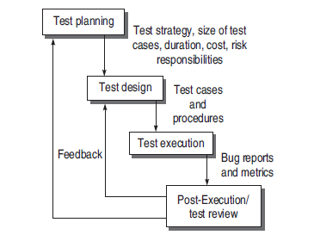
Fig. Software Testing Life Cycle(STLC)

Slide 6
Test Planning
The goal of test planning is to take into account the important issues of testing strategy, viz. resources, schedules, responsibilities, risks, and priorities, as a roadmap.
Test planning issues are in tune with the overall project planning.
Broadly, following are the activities during test planning:
Defining the test strategy.
Estimate the number of test cases, their duration, and cost.
Plan the resources like the manpower to test, tools required, documents required.
Identifying areas of risks.
Defining the test completion criteria.
Identification of methodologies, techniques, and tools for various test cases.
Identifying reporting procedures, bug classification, databases for testing, bug severity levels, and project metrics.

Slide 7
Based on the planning issues as discussed above, analysis is done for various testing activities.
The major output of test planning is the test plan document.
Test plans are developed for each level of testing.
After analyzing the issues, the following activities are performed:
Develop a test case format.
Develop test case plans according to every phase of SDLC.
Identify test cases to be automated (if applicable).
Prioritize the test cases according to their importance and criticality.
Define areas of stress and performance testing.
Plan the test cycles required for regression testing.

Slide 8
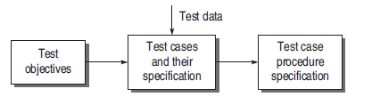
Test Design
It includes the following critical activities.
Determining the test objectives and their prioritization
-Preparing list of items to be tested
-Mapping items to test cases
-Selection of test case design techniques
Creating test cases and test data
Setting up the test environment and supporting tools
Creating test procedure specification

Slide 9
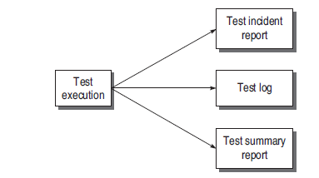
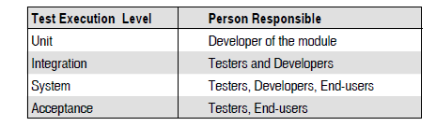
Test Execution
In this phase, all test cases are executed including verification and validation.
Verification test cases are started at the end of each phase of SDLC.
Validation test cases are started after the completion of a module.
It is the decision of the test team to opt for automation or manual execution.
Test results are documented in the test incident reports, test logs, testing status, and test summary reports.
Fig. Documents in test execution
Fig. Testing level vs responsibility

Slide 10
Post-Execution/Test Review
After successful test execution, bugs will be reported to the concerned developers. This phase is to analyze bug-related issues and get feedback so that maximum number of bugs can be removed.
As soon as the developer gets the bug report, he performs the following activities:
-Understanding the bug
-Reproducing the bug (confirm the bug and cross verify failure)
-Analyzing the nature and cause of the bug (debugging, report to testing team)

Slide 11
Thank you!

